Slide 1

HealthCare Diagnosis Ramil Valiyev

Slide 2

Statement of Problem
The statement of the problem for a healthcare diagnosis project aimed at distinguishing between COVID-19 and influenza based on user-provided symptoms

Slide 3

Objective
The objective of this project is to create a user-friendly and accessible system that,enabling a rapid and reliable determination of whether the user is likely to be affected by COVID-19 or influenza.

Slide 4
Bayesian Networks
Probabilistic Modeling
Exact Inference
Adaptability and Learning

Slide 5
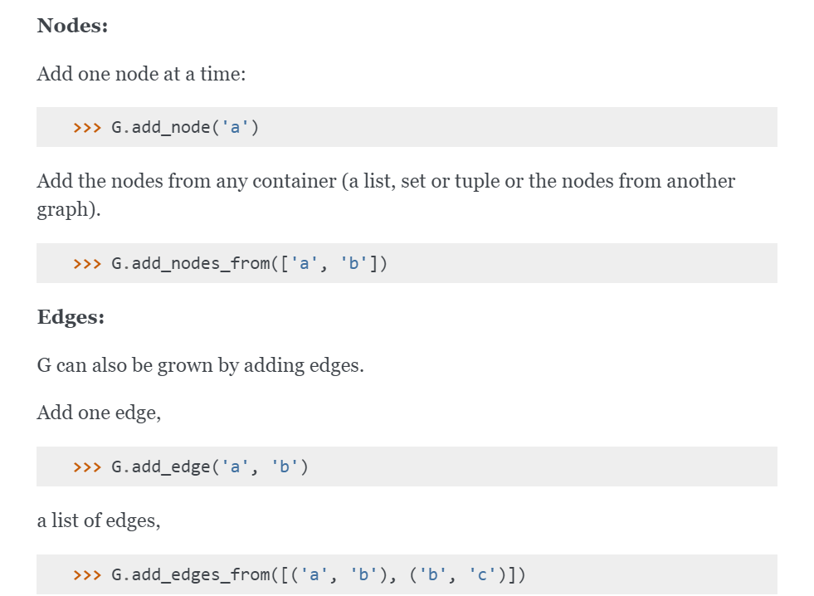
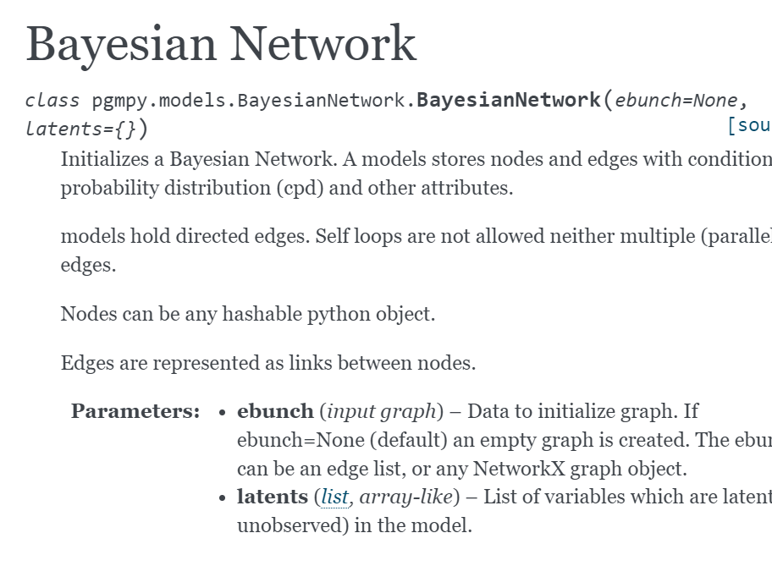
from pgmpy.models import BayesianNetwork

Slide 6
Explanation of Library
Probabilistic Graphical Models: pgmpy supports the creation, manipulation, and analysis of different types of probabilistic graphical models, including Bayesian Networks, Markov Networks, and Factor Graphs.
Bayesian Networks: Bayesian Networks are the primary focus of pgmpy. These are graphical models that represent probabilistic relationships among a set of random variables using a directed acyclic graph (DAG). Each node in the graph represents a random variable, and the edges represent probabilistic dependencies.

Slide 7
from pgmpy.estimators import MaximumLikelihoodEstimator
This is a fundamental step in building Bayesian Networks when the exact probabilities of the relationships between variables are not known beforehand and need to be learned from data.
Model & data

Slide 8
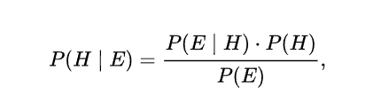
Bayes ‘ theorem
Bayesian Networks involves computing conditional probabilities based on observed evidence. The key mathematical concept here is Bayes' theorem, which relates the conditional probability of an event given evidence to the prior probability of the event and the probability of the evidence given the event.

Slide 9
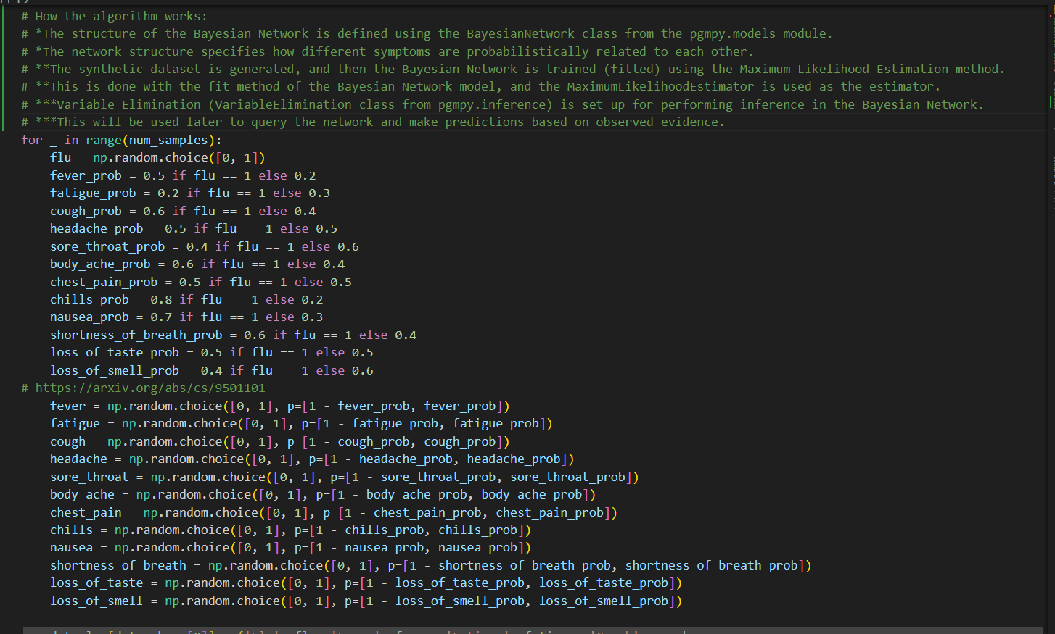

Slide 10
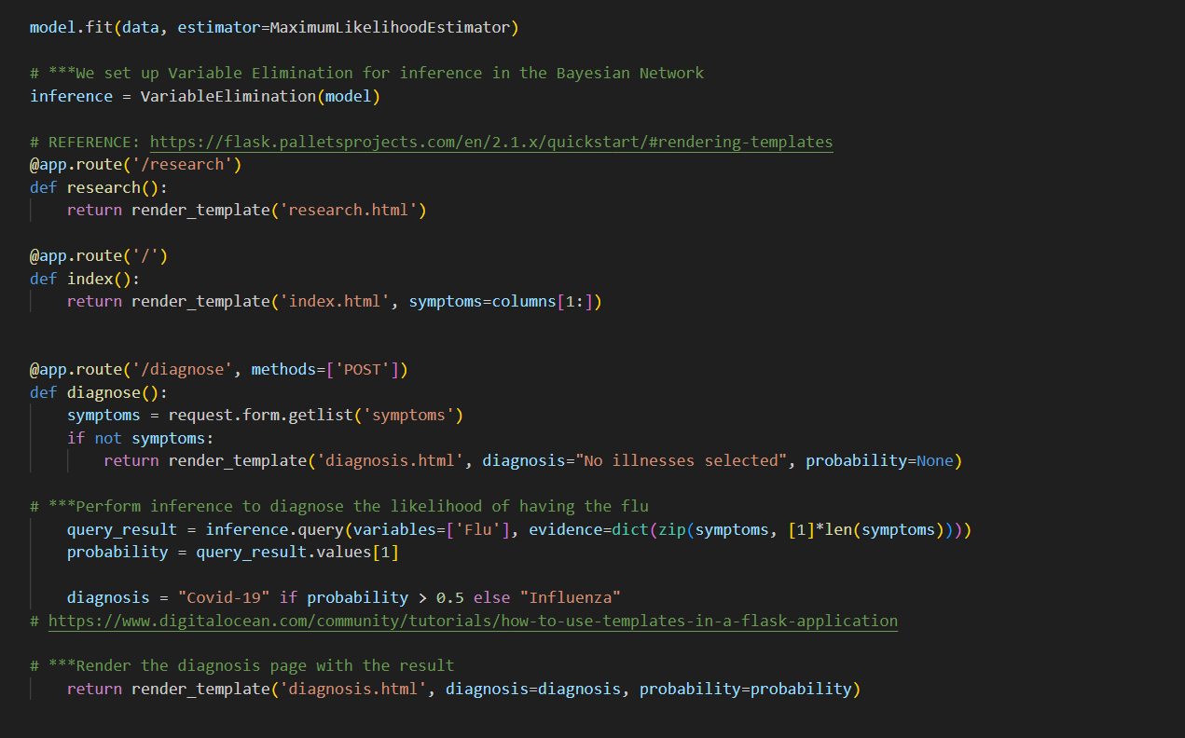

Slide 11
Visualization
https://github.com/ramilvl/HealthCare_Diagnosis_AI

Slide 12


Slide 13
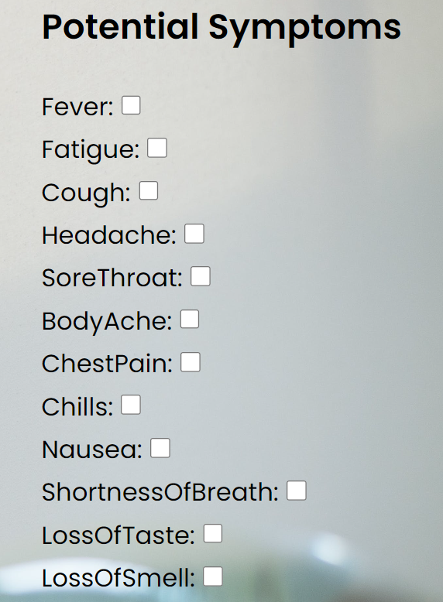

Slide 14
